Slide 1
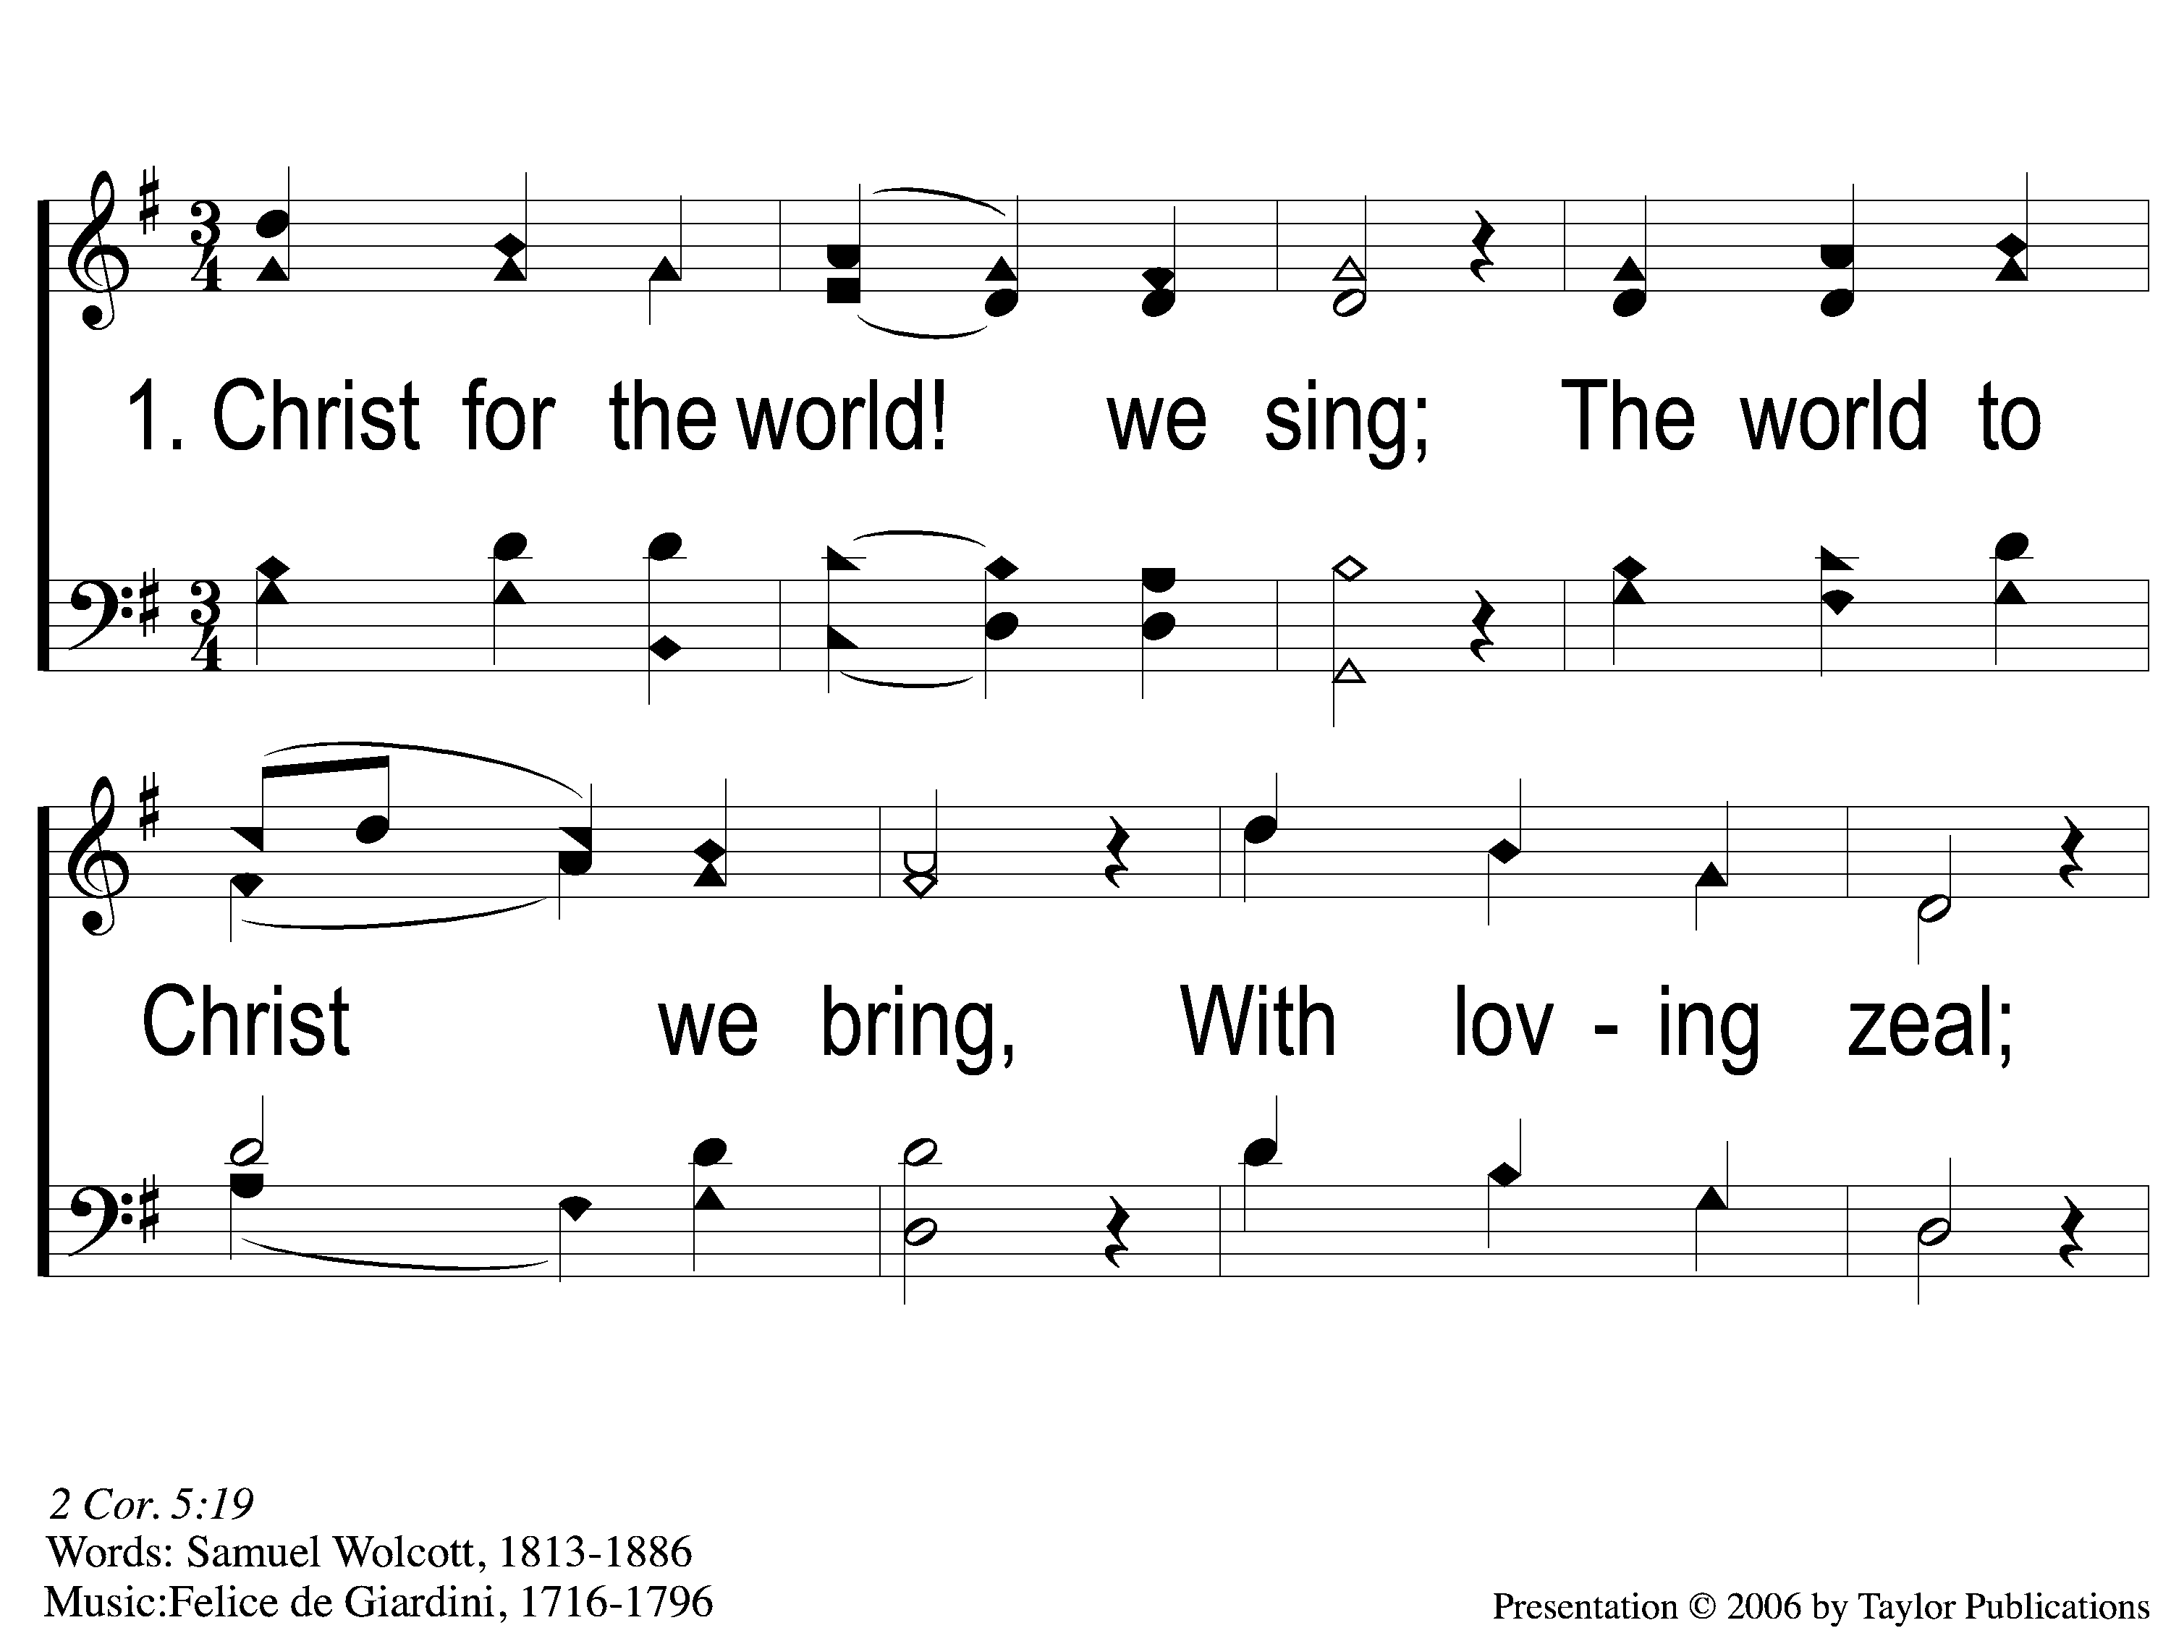
1-1 Christ for the World we Sing
Christ For the World We Sing
60

Slide 2
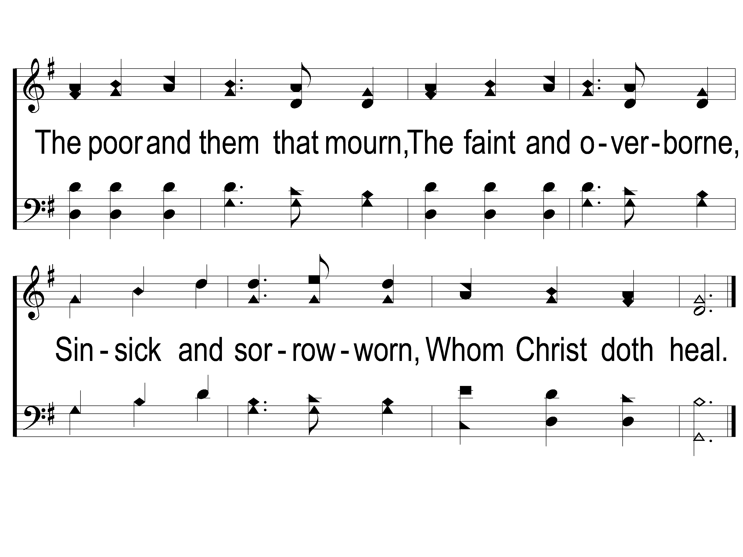
1-2 Christ for the World we Sing
Christ For the World We Sing
60

Slide 3
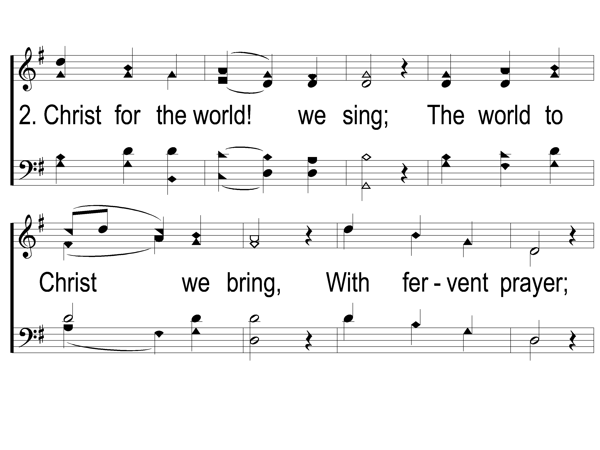
2-1 Christ for the World we Sing
Christ For the World We Sing
60

Slide 4
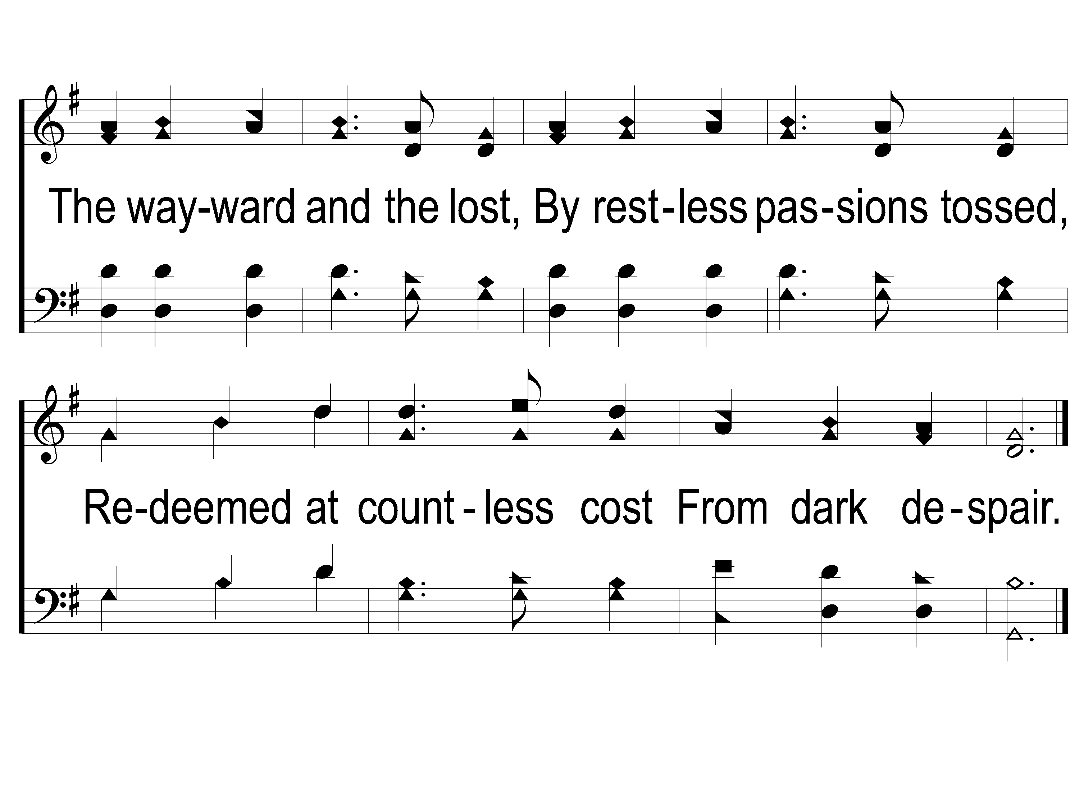
2-2 Christ for the World we Sing
Christ For the World We Sing
60

Slide 5
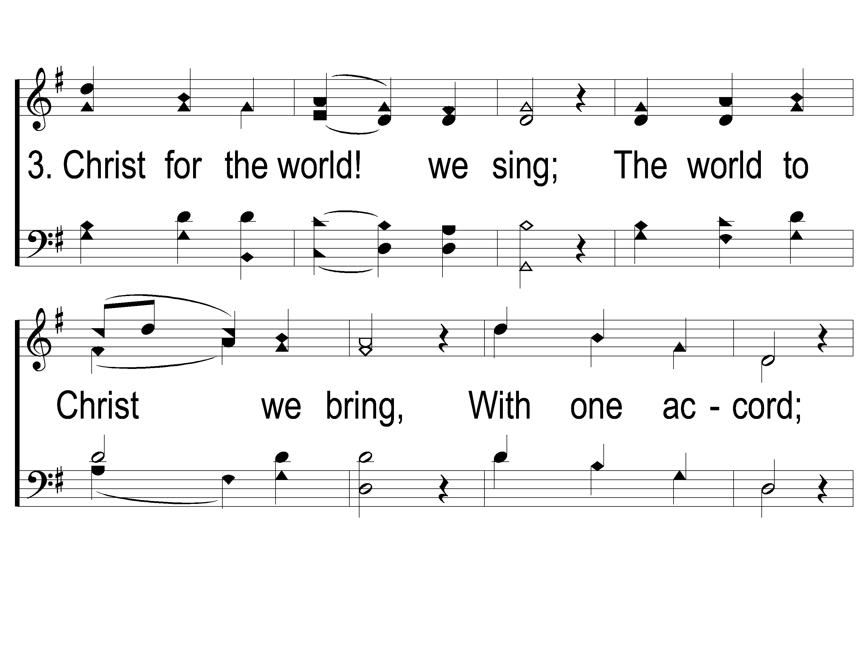
3-1 Christ for the World we Sing
Christ For the World We Sing
60

Slide 6
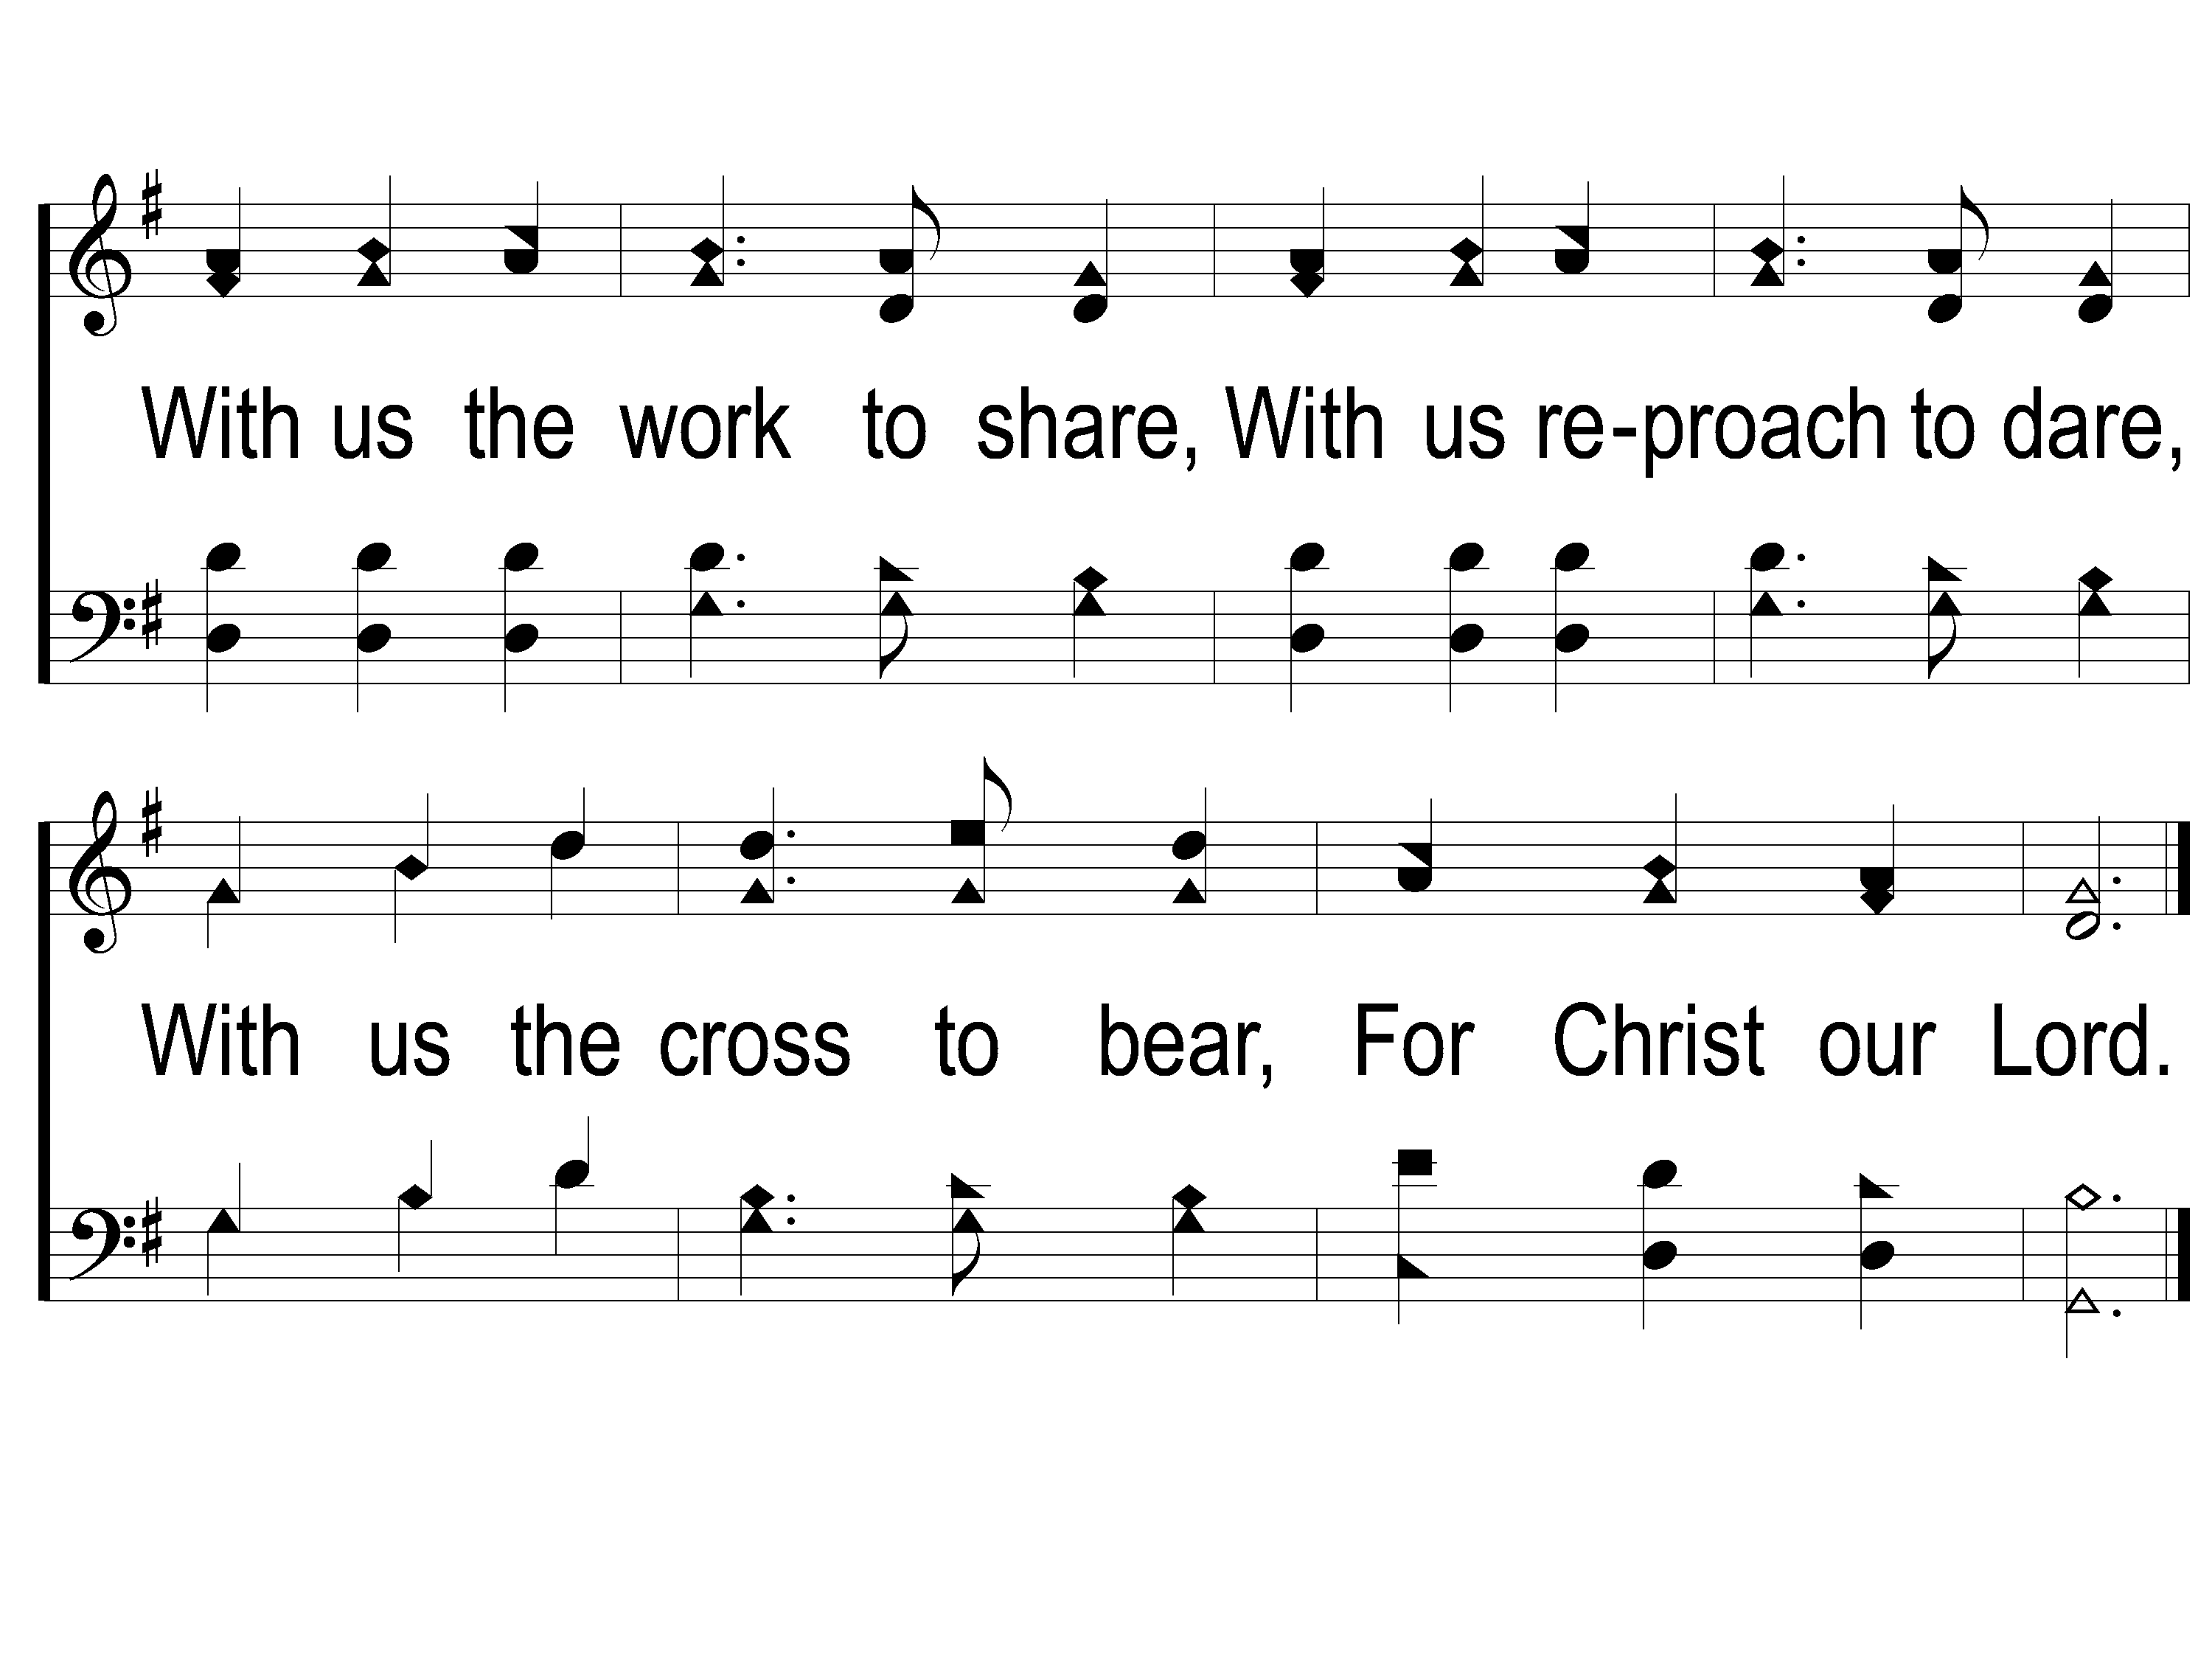
3-2 Christ for the World we Sing
Christ For the World We Sing
60

